Slide 1

By: Rudra Patel, Bill Colak, Suchetan Bir

Slide 2
Agenda
Personas & Epics
Testing
Architecture
Product Vision & Description
Technology
Implementation

Slide 3

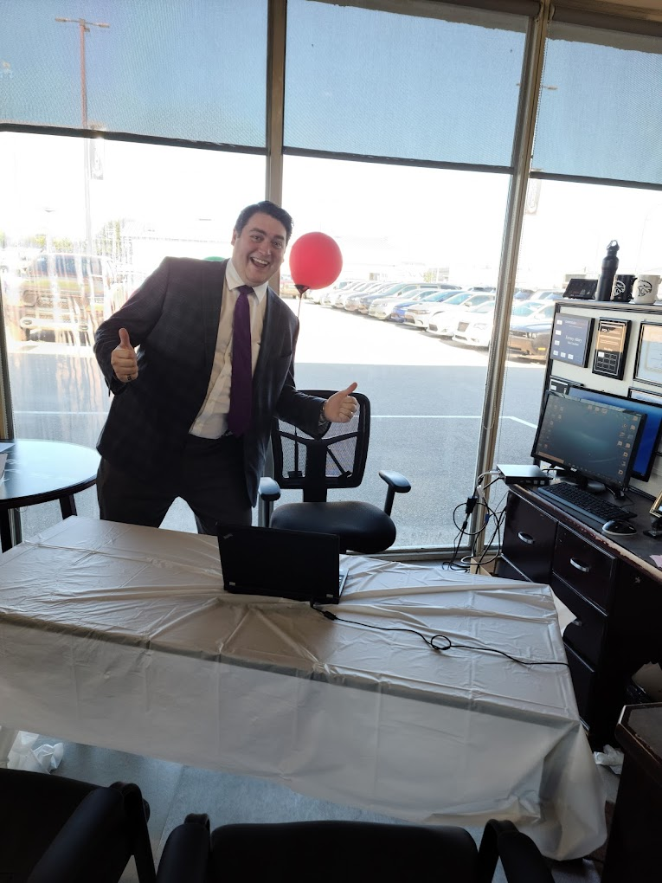

Product Description
The Web app that will track sales of vehicles for Riverside Dodge, a car dealership in Prince Albert
It fills a gap concerning collection of sales data. Their current way of handling this has less features than they would like.
Prevent human errors.
Closely Integrate staff & business through technology (i.e.) real time changes.
Make sales data entry and tracking more intuitive.

Slide 4
Persona / Roles
JeffSaleIntern
JimmyFinanceEmployee
DorothySalesManaegr
StevenAdministration
JennaHumanResources
ChadSeniorSalesAssociate
Ryan
Considered different areas:
Background
Technology Experience
Job Position [i.e., owner, intern, etc.]
Goals and Needs
Motivation
Activities
Frustrations

Slide 5
Personas [Basic Description]
JimmyFinanceEmployee
A 24-year-old Finance Employee who works for a car dealership, who want to be as efficient as possible in his job. His experience in technology is limited to what he encounters at work.
DorothySalesManager:
32-year-old sales manager who handles both new and used car sales when they come in and who wants to have all the information needed to make her job easier. She prefers pen and paper, so her experience with technology is very limited.
StevenAdministration
A 37-year-old car dealership owner, who want to monitor his employees progress and actions within the system. His experience in technology is very limited to desktop but proficient in touch screen interface.

Slide 6
Personas [Basic Description]
JeffSaleIntern
24-year-old Sales intern at the car dealership who want to be able to keep his job and spend minimal about of effort working. He is having difficulty learning anything new with technology.
JennaHumanResources
28-year-old HR administrator and handles employee's payment, contracts and holiday leaves. She wants a system to do some of her work faster. She has lot of experiences in technology and with different software.
ChadSeniorSalesAssociate
35-year-old man Senior Sales Associate who is good at everything he does. He want to make software as fast as possible to save time and be more productive. He know most programming languages and good in technological equipment
Ryan
22-year-old part time employee at the car dealership and university student pursing business and finance. He want to learn how sales are being processed. He has sufficient experience in technology.

Slide 7



Roles
Product Owner
Scrum Master
Scrum Team Members
The central point of product leadership.
Manage Economics
Participate in the planning
Observe the team using Scrum.
Does anything possible to help the team get to the next level of performance.
Includes: Programmer, testers, database admin, UI designers
Planning the sprint

Slide 8
Personas
Name: Steven
Role: Administration and Owner
Description: Steven is a 37 year old man and he is the owner of the car dealership, has 3 kids and a nice loving family. He handles all the personnel involved in the dealership and plans out all its operations. He thinks that a system where he can monitor and track every employee’s progress and can segregate everyone according to their role should be brought into the dealership. He wants to have less interactions with employees and and the dealership in general and act more like an observer. He is not that tech savvy but has experience with desktop computers.
Name: Dorothy
Role: Sales Manager
Description: Dorothy is 32 and married to Steven, the owner of the company, with 3 children. She is the full time sales manager of the dealership, she deals and supervises sales of new and used vehicles as the appear. She wishes to have all the sales information stored in one place, from where she can view and edit it, making her job a lot more easier than manually writing the sales in a paper and referencing different papers, after they get filled up.

Slide 9
Personas
Name: Jeff
Role: Sales Intern
Description: Jeff is a 24 year old sales intern, trying to keep his job while spending minimal efforts. He is technologically challenged and finds it hard to learn anything new. He has dyslexia, ADHD and is also colour blind.
Name: Chad
Role: Senior Sales Associate
Description: Chad is a 35 year old man, a gym lover who is good at everything he does. Does not waste time, and likes everything to be near perfect. Since he joined 5 years ago, his sales numbers are exceptional and way ahead of his fellow associates. His technological grasp is impeccable. His motivation is to be able to get a better system implemented in the company which is faster and efficient .

Slide 10
Personas
Name: Jenna
Role: Human Resources
Description: Jenna is 28 years old and is the HR administrator, handling the paystubs, commissions, leaves, and general employment related tasks. She is frustrated on wasting time on tasks that can be easily automized, like calculating paystubs. She has good technical grasp and has experience with various different types of softwares throughout her career.
Name: Ryan
Role: Part time sales associate
Description: Ryan is a 22 year old, part time sales associate, pursuing a bachelor’s in business in the university. He is here trying to learn business and sales as a side task. As he spends little time at job, so whenever he has a shift, he wants to be updated on what sales have happened and what tasks are handed to him.

Slide 11
Personas
Name: Jimmy
Role: Finance Employee
Description: Jimmy is 24 and works as the finance employee. He is single and lives with roommates. He has to review sales for new and used cars and ensure the profits and costs and everything are matching with the expected amount. He is very hard working and often works overtime to get his work done. He wants to get his work done quickly so that he can meet his daily goals more consistently. His technological knowledge is limited to what he uses at work. But he is a quick learner.

Slide 12
Epics
Steven: As the owner I want to change different users’ privileges in regards to accessing, modifying, and creating data within the system as well as privileges regarding viewing other peoples’ work so that I can change peoples’ permissions as their requirements for work change.
Dorothy: As the SalesManager I want to set, edit, and delete target sales goals and have those target sales goals compared to actual sales within certain time frames, so that I can see where changes need to be made.

Slide 13
Epics
Jenna: As a Human Resources, I want to create, delete, and share tasks with the employees below me so that I can coordinate our efforts easily and quickly.
Ryan: As a part time employee, I want to be able to see a summary of events that occurred within the system since I last used it so that I can keep up with the events of the company.
Chad: As Senior Sales Associate, I want to create, delete, and share tasks with the employees below me so that I can coordinate our efforts easily and quickly.

Slide 14
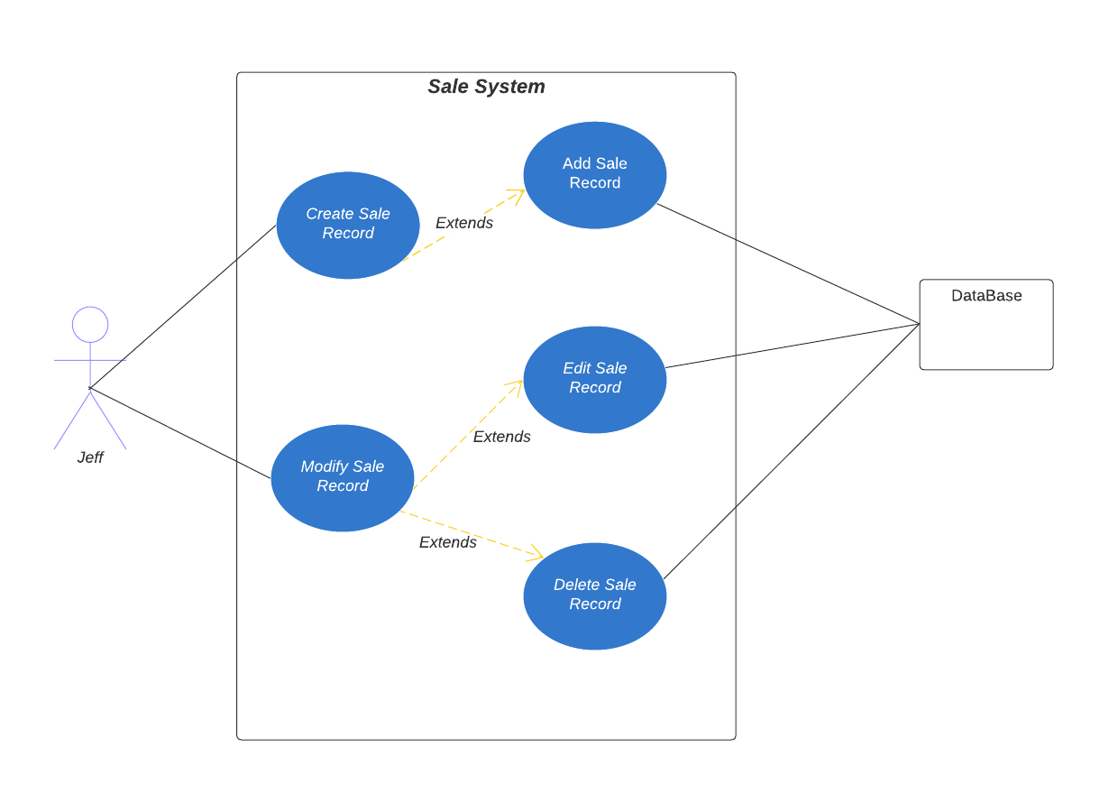
Epics
Jeff: As a Sales Intern I want to add, modify and delete new and used car sales so that I can keep my job as a sales intern.
Chart representing the use case diagram of Jeff’s epic requirements.

Slide 15
User Stories - Requirements
As a FinanceEmployee
I want to be able to export new and used car sales into a desktop readable file
I want to view all the data for new and used car sales for a specific month in a chart format
I want to view all new and used car sales by one specific person with a table and a chart so that I can track that person's commission.

Slide 16
User Stories - Requirements
As a SalesManager
I want to set sales goals for a specific month so that I can track real progress with estimated progress.
I want to delete sales goals for a specific month so that I can save storage space
I want to edit sales goals for a specific month so that I can revise errors if needed.
I want to review sales goals to real sales so that I can see end of year progress easily

Slide 17
User Stories - Requirements
As Administration
I want to enable creation permissions of new and used car sales for one person within the system so that I can allow the employee to more easily do their job
I want to disable creation permissions of new and used car sales for one person within the system so that I can free up their time to complete other tasks
I want to enable/disable viewing privileges on new and used car sales for one person within the system so that I can change their access depending on their status

Slide 18
User Stories - Requirements
As SalesIntern
I want to create a new car sale that is either new or used and add it to the system so that I can track my progress as a sales intern
I want to edit a car sale that is either new or used so that I can change the mistakes I make
I want to delete a car sale that is either new or used so that I can scrap my mistakes if they become too large

Slide 19
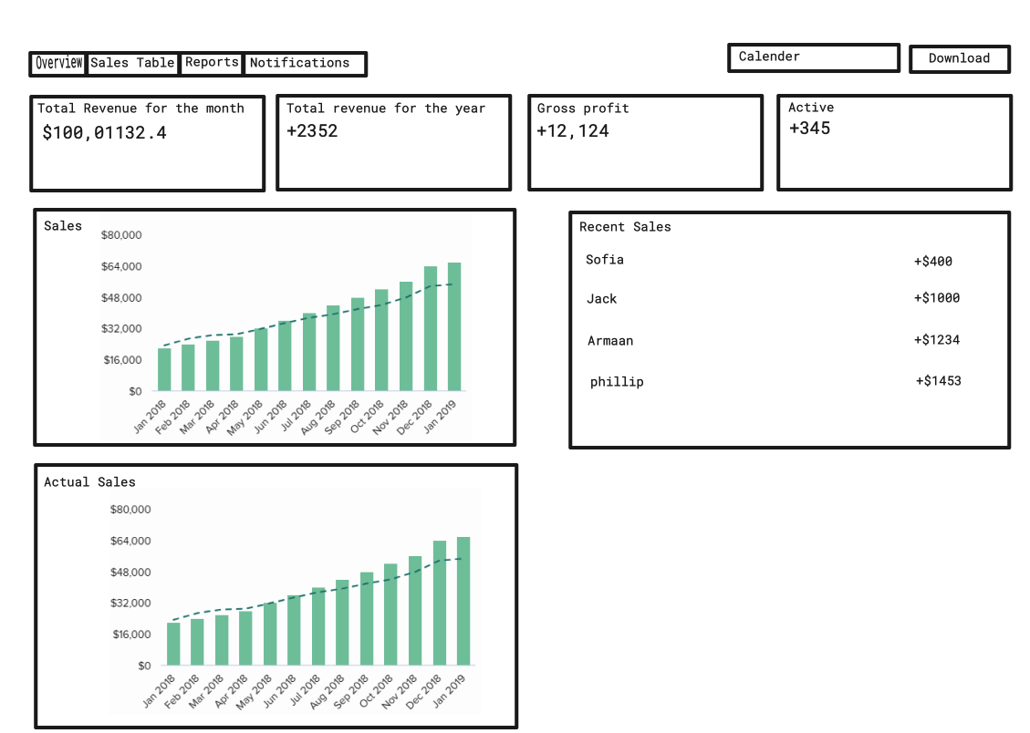
Story Board

Slide 20
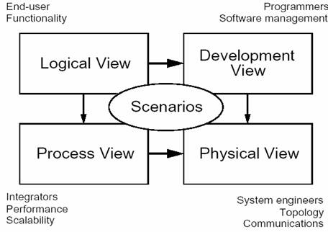
Architecture
Kruchen’s 4+1 model, 5 facets of the program
Logical View – End-user functionality
Implementation – units/decisions of development
Physical – Infrastructure
Process View – Tasks/Processes involved
Scenarios – architecturally significant use cases
Notes:
Krutchen 4+1 model
Logical view:
layers(backend frontend): storage logic/middleware ui
frameworks(Next.js React.js Express.js)
functional requirements(what should the system do for it's end users)
major design packages tailwind shadcn
Employee interface
Admin interface
Webserver
Database
Process view:
Concurrency
Performance
Scalability
Maintainability
Reliability
Implementation view:
Tools
Environments
Development environments
Coding standards(reusability, cohesion, etc)
Development Methodology
Version control
Build system
Physical view:
Infrastructure
Server
Network
Hardware
Ask Ryan about the deployment
Scenarios views:
testing website
User roles: Administrator and Employee. Roles base authentication where components / pages conditionally render.
Vercel - Deployment
Pipelines – for testing.
Local – Gitlab – pipeline (some tests / builds ) - deployed on vercel. Every branch has this set up not just main. So we can see each others versions.
Ex: https://bill.codeallergy.dev/authentication
User roles: Administrator and Employee. Roles base authentication where components / pages conditionally render.
Vercel - Deployment
Pipelines – for testing.
Local – Gitlab – pipeline (some tests / builds ) - deployed on vercel. Every branch has this set up not just main. So we can see each others versions.
Ex: https://bill.codeallergy.dev/authentication

Slide 21
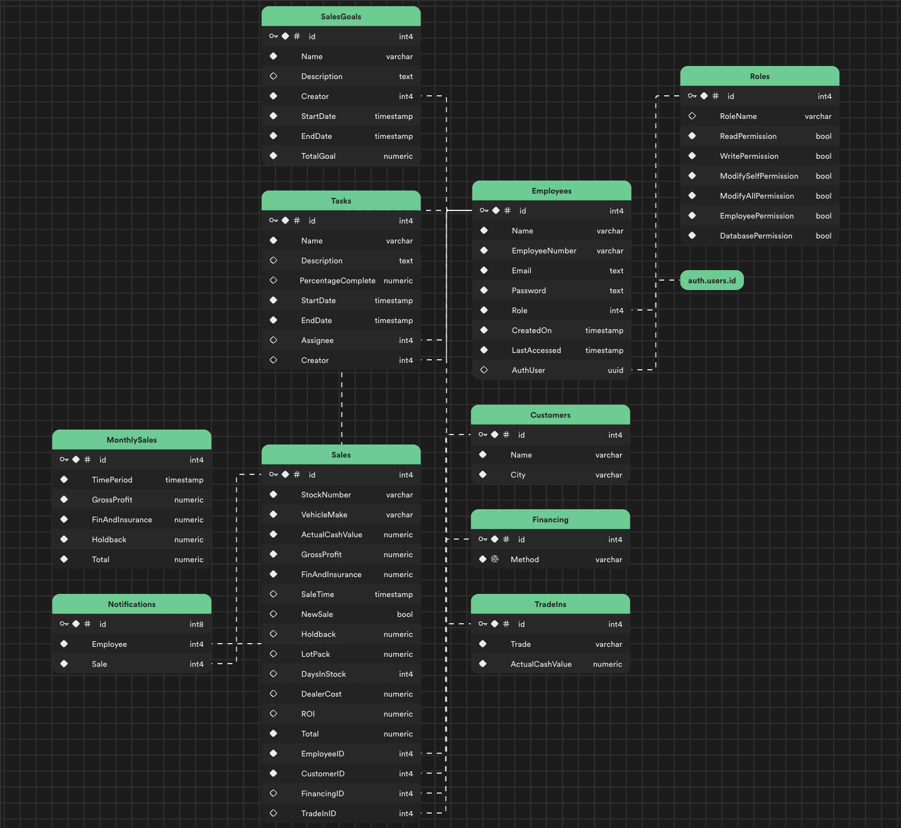
Logical View
List of the most important functional requirements:
Two different Roles: Admin/ Employee
User role: Admin
Dashboard Component:
Summary charts(Total sales, profit, best-selling, etc.)
Customizable charts for sales performance.
Timeframe selection for data analysis.
Sales Table Component:
Add, modify, and delete sales.
Real-time filtering by category.
Sales Goal Table Component:
Create, modify, and delete sales goals.
Task Table Component:
Create, modify, and filter tasks.
Training and Reference Component:
Create and edit training and reference articles.
Settings Component:
Administrative actions (change roles, add/delete employees).
Theme toggle and user profile management
User role: Employee:
Sales overview
Assigned Tasks CRUD sales
Assigned Training
Notes:
3 Layers: db (storage), middleware(auth), UI Next js –Full Stack

Slide 22
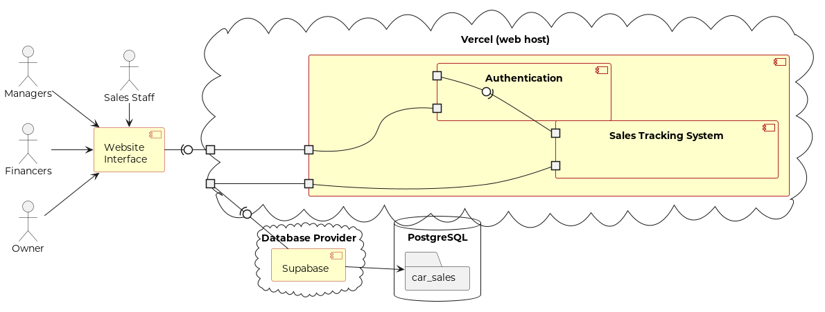





Implementation View:
Tools and environments:
WebStorm
Git/Gitlab
Storybook
Qodana
Jest
Development Methodology:
Agile
Scrum meetings
Framework:
Next.js
Frontend:
React.js
Typescript
Tailwind
Radix UI
Backend:
Supabase
Vercel
Backend:
Utilizes Superbase as the database.
SQL queries for creating database schema and mock data.
Authentication:
Employee and admin login with credentials stored in Superbase.

Slide 23






Implementation View cont.
Coding standards:
Used typescript to stop type errors
Thorough testing using Storybook and Jest
Keeping Track of code quality using Qodana
Modular coding to maximize reusability
Role specific Data providers
Data is only passed and confined within a specific component
Minimizing Coupling by keeping files separate and organized

Slide 24

Deployment View
Environment:
Node Project.
Hosted Remotely on Vercel.
Dependencies:
Node.js for server-side operations.
Supabase for database services.
Notes:
Dynamic hosted on Vercel.

Slide 25
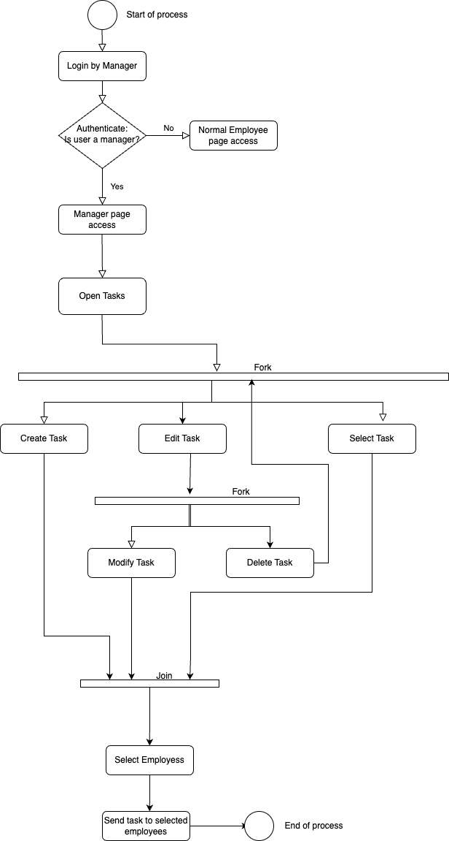
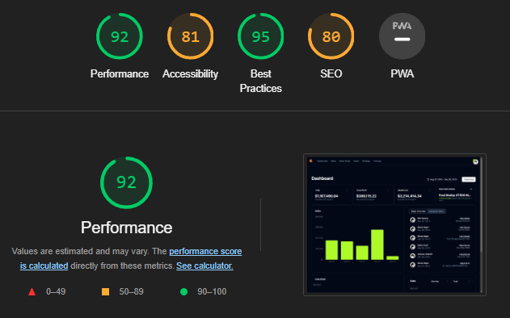
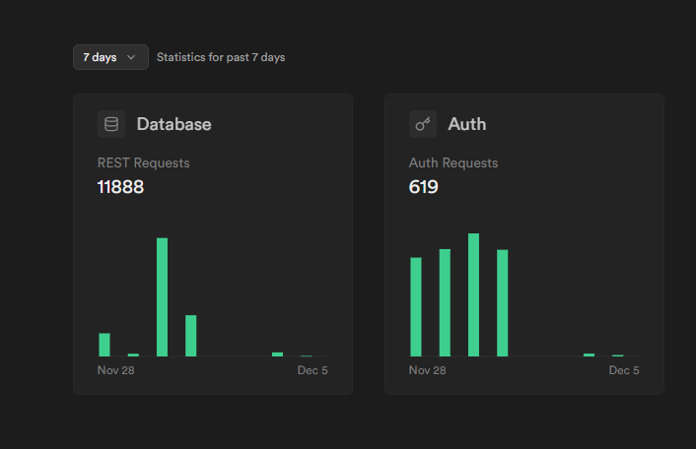
Process View
Performance:
builds
response time – light report
Scalability:
how many dealership we can sell this to? 🡪 we can only sell this to two dealership, or we pay for it. 2 projects for free. If the needs of the business is the same, the web app is infinitely scalable.
Pros of Supabase is that its mobile friendly, used by mobile apps. It combine all the data from different sources into one place.

Slide 26
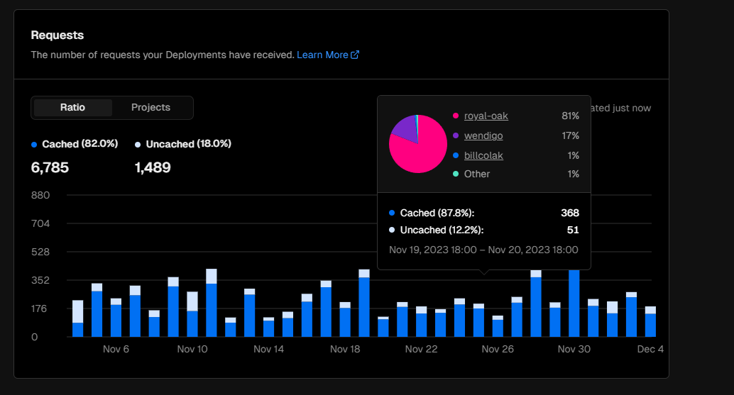
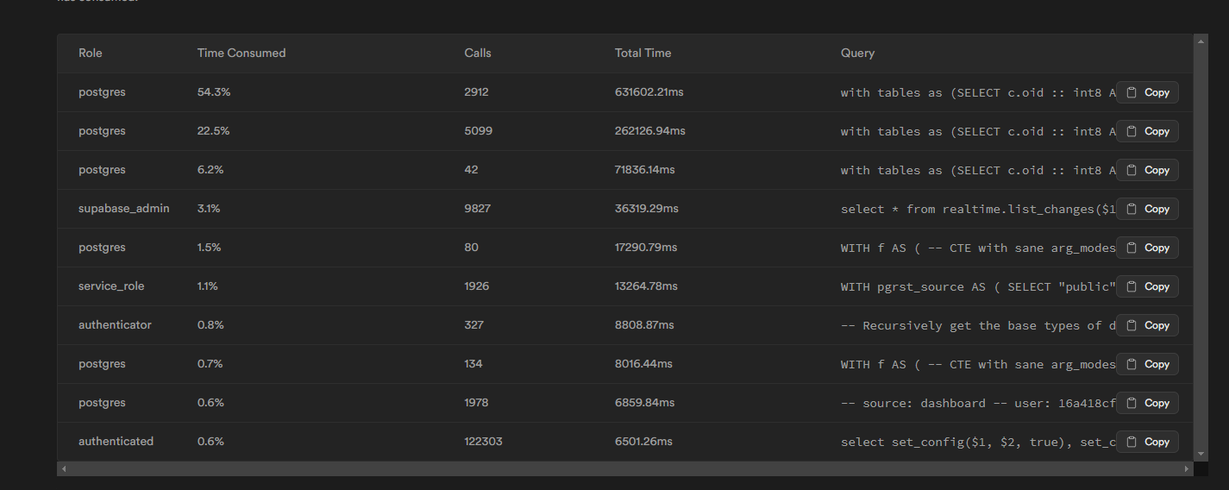
Process View cont.
Concurrency:
multiprocessing / threading
hardware scalability – given service provider.
React – components refresh instead of pages
DDOS protection / attacks
Fault Tolerance:
the app uses a lot error handling, to deal with faults gracefully and in a modular way.
If one-part errors out/ it just doesn’t show – this is a feature of react / JavaScript
Next uses a lot of CDN for fast content delivery. Provides image optimization and other convenient features. System wide errors are handled by Vercel / AWS. These situation are outside of our control. App
after fixing you have to redeploy which takes around 10 mins.

Slide 27
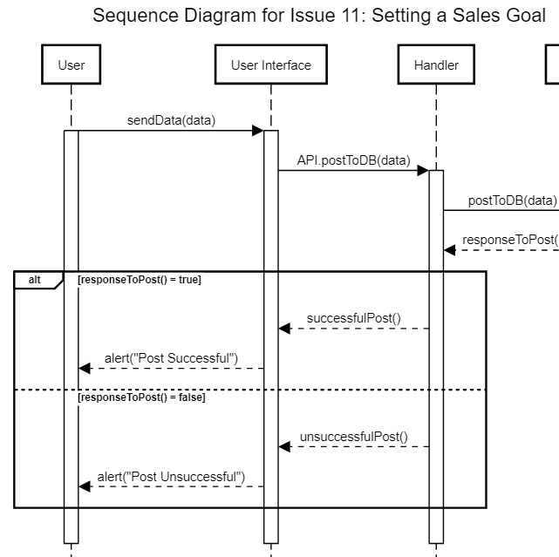
Use Case View
Different use cases designed based on the use role
Admin Use Cases:
Manage sales data, goals, tasks, and training articles.
Perform administrative actions (add/delete employees, change roles).
Employee Use Cases:
View personalized dashboard and tasks.
Add, modify, and delete personal sales.
Access training and reference articles.
Modify personal settings.

Slide 28

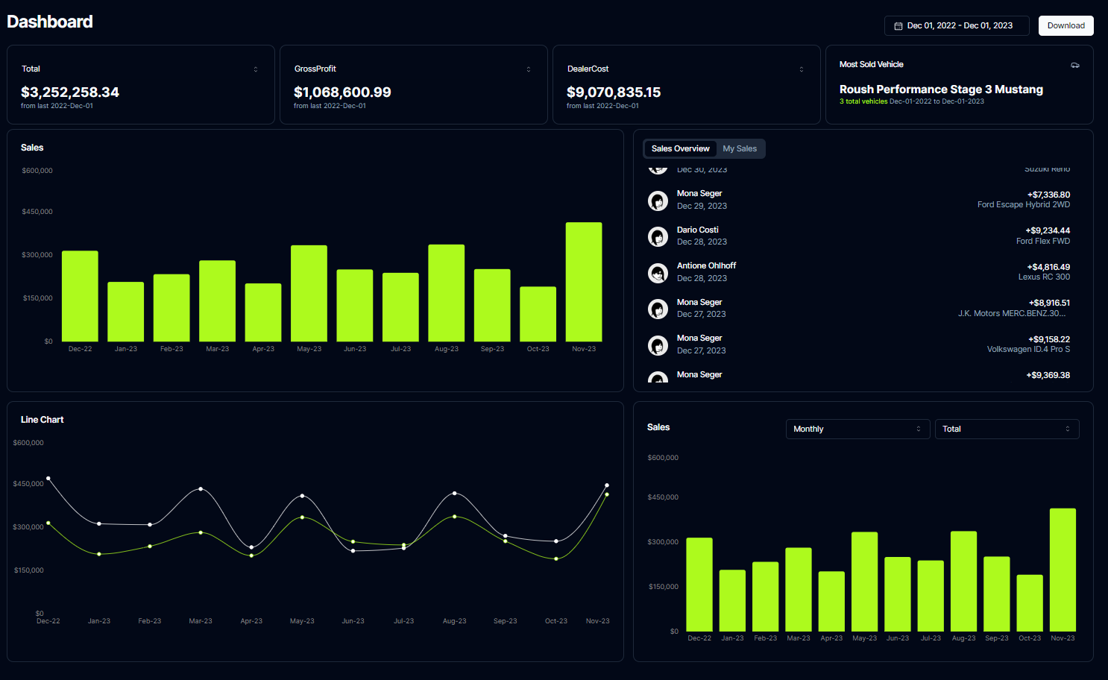

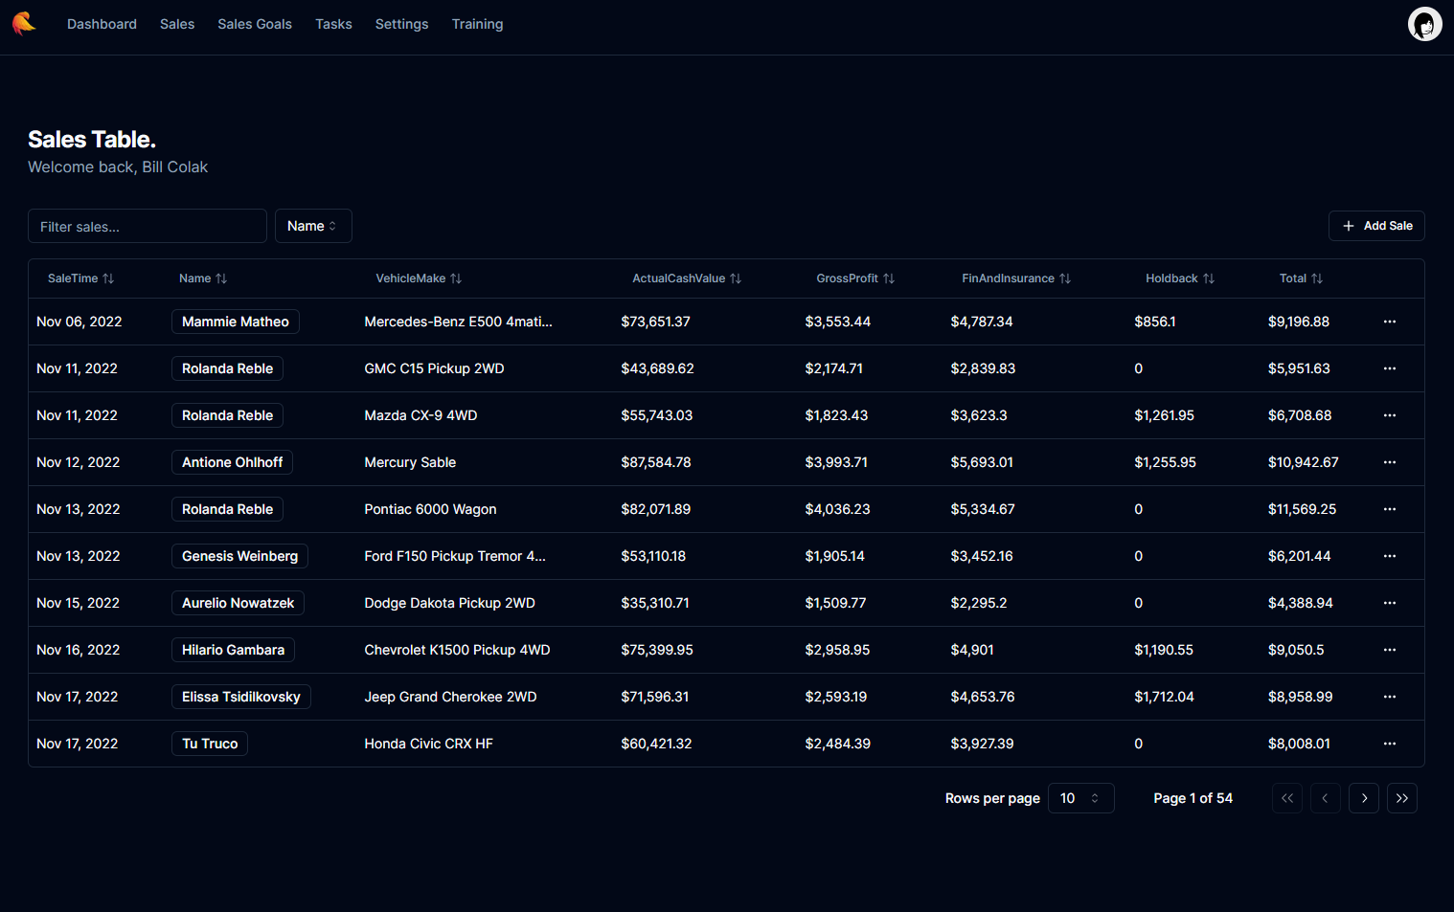

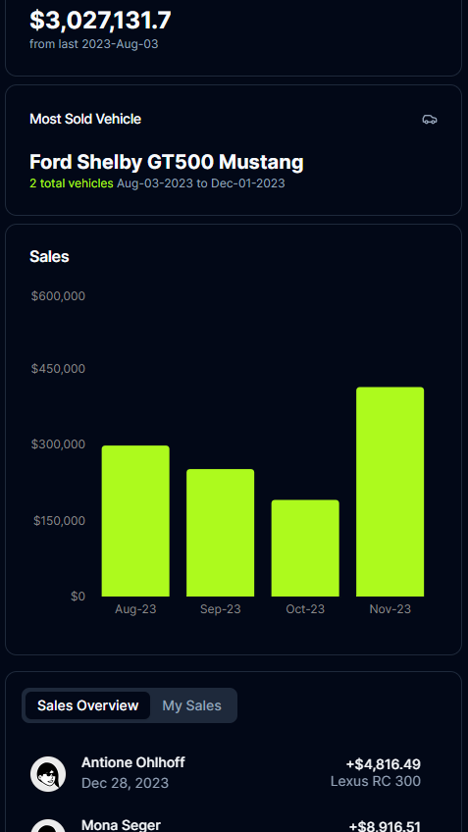
Implementation of User Stories

Slide 29
Features
export the data to a CSV file - 2 points
view all the data for sales for a specific month - 5 points
view all new and used car sales by one specific person - 2 points
Set, delete, edit sales goals for a specific month – 3 points
Compare estimated with actual sales – 4 points
Enable, disable creation & viewing permissions (Roles) - 4 point
Add, edit, delete sales – 3 points
Review recent sales. – 3 points
Create, edit, delete tasks – 3 points
Add, delete, edit reference & wiki pages. – 3 points
Total – 32 points/ 32

Slide 30
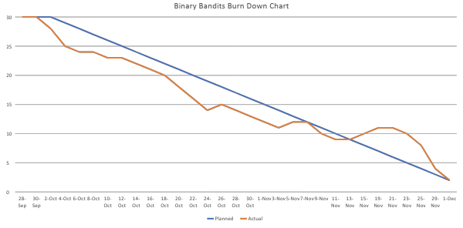
Burn Down Chart

Slide 31
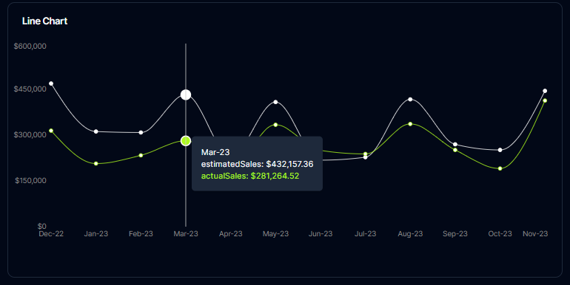
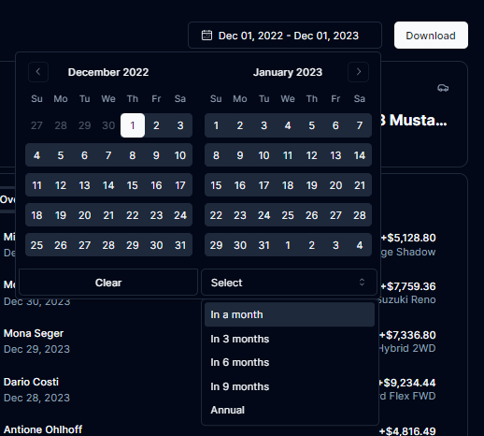
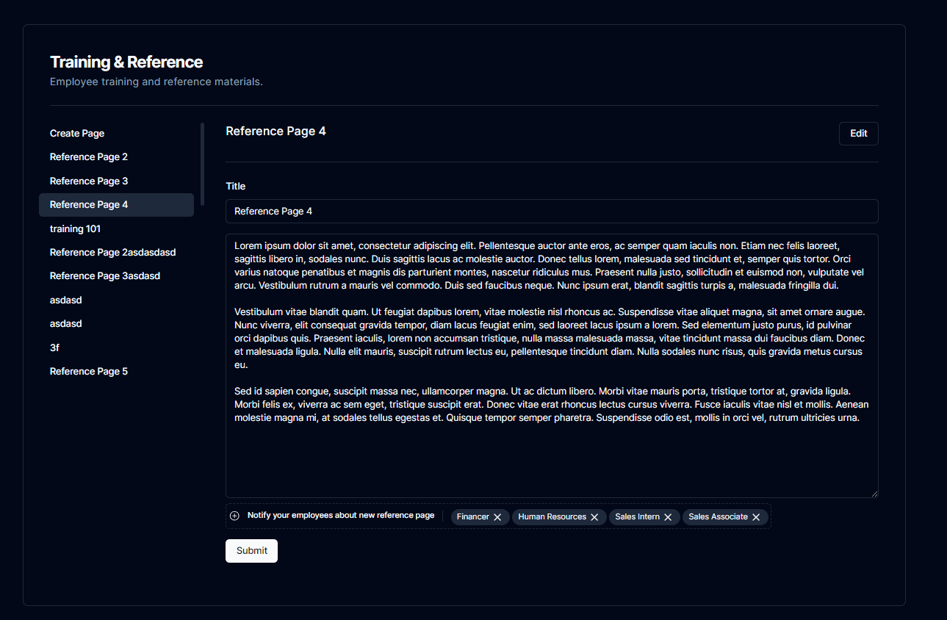
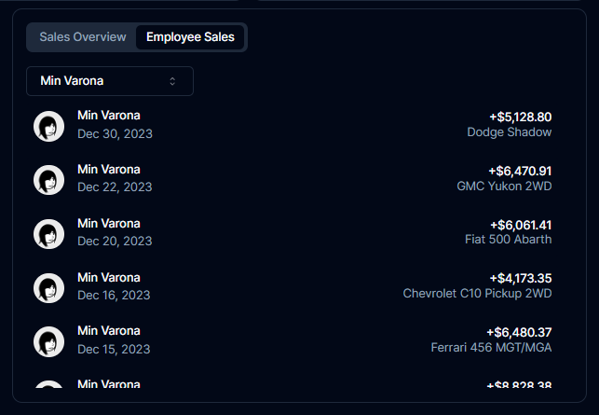
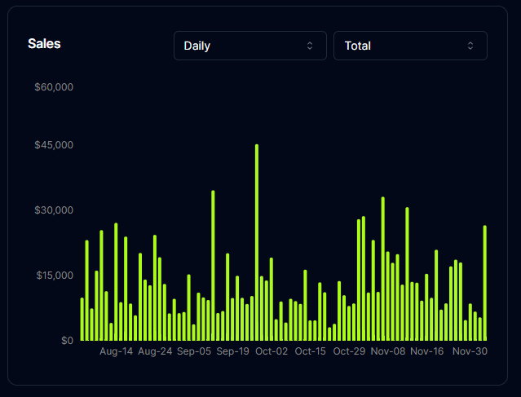
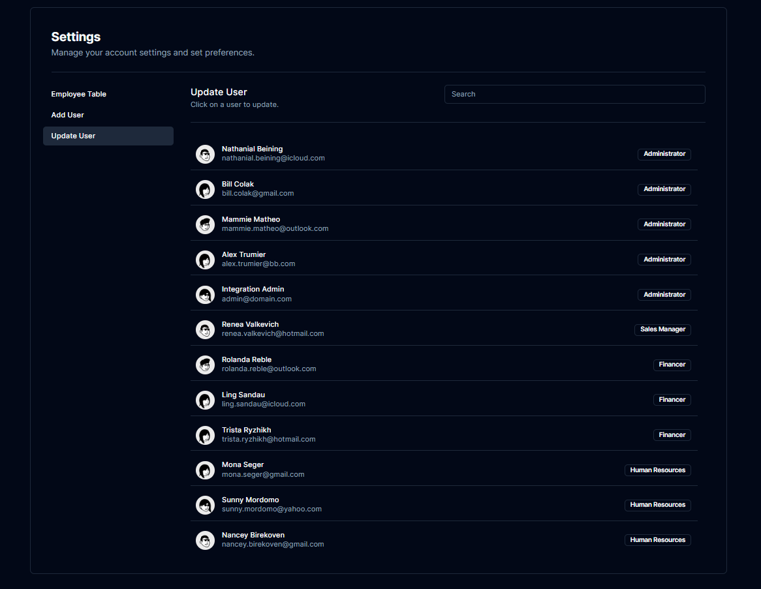
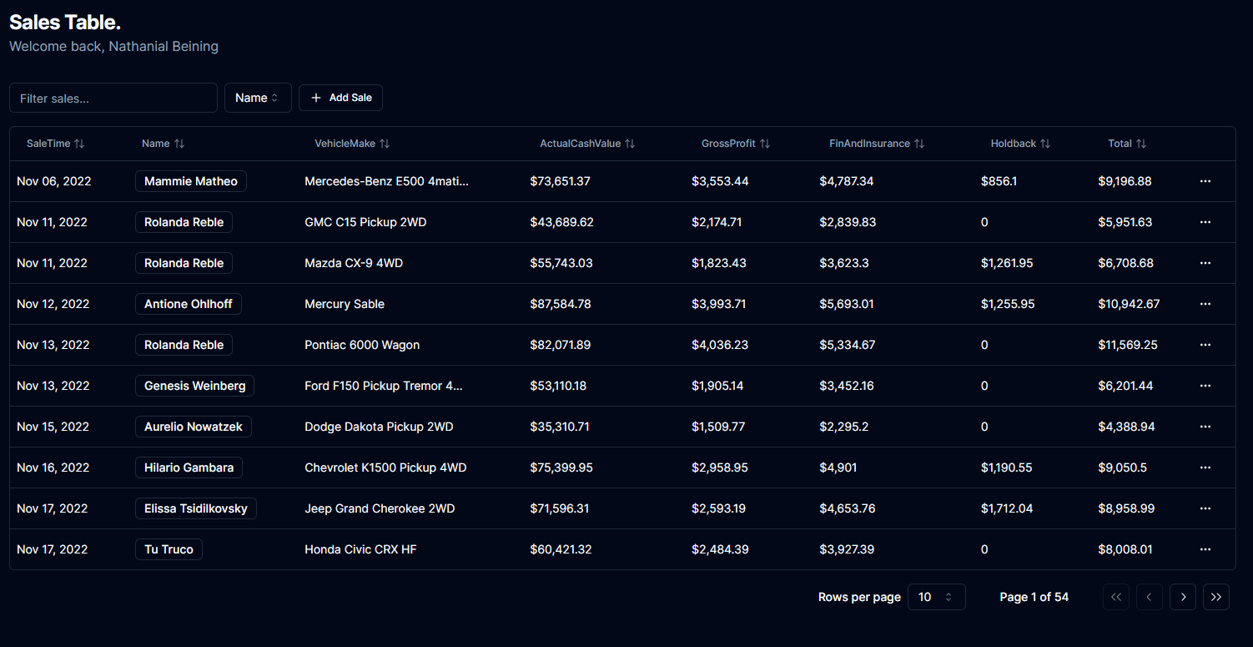

Slide 32
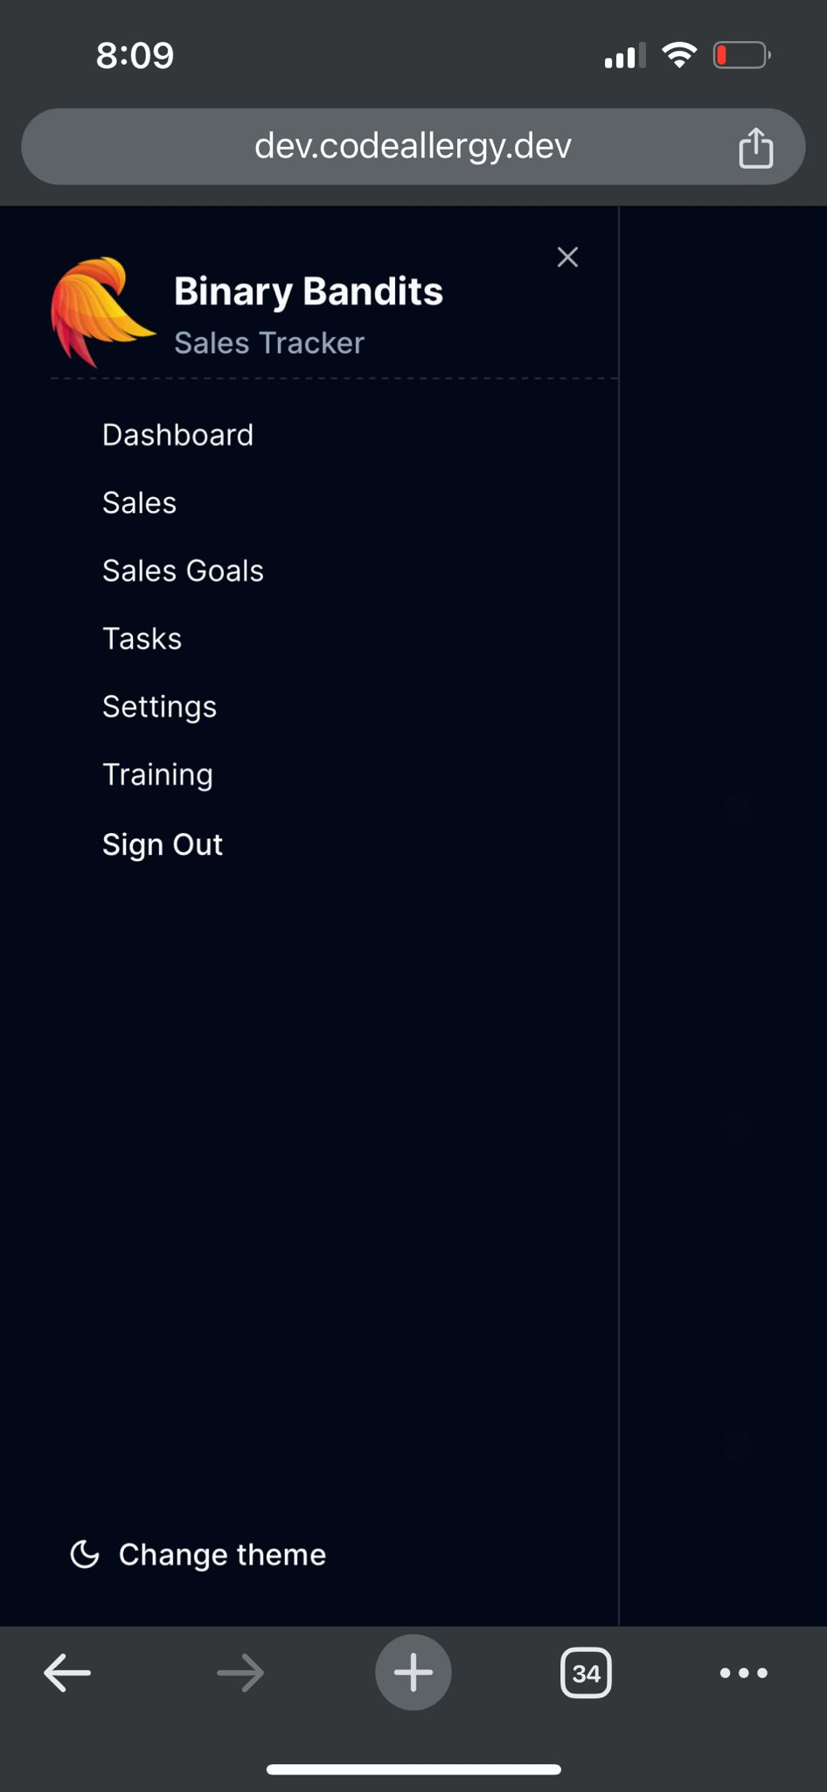
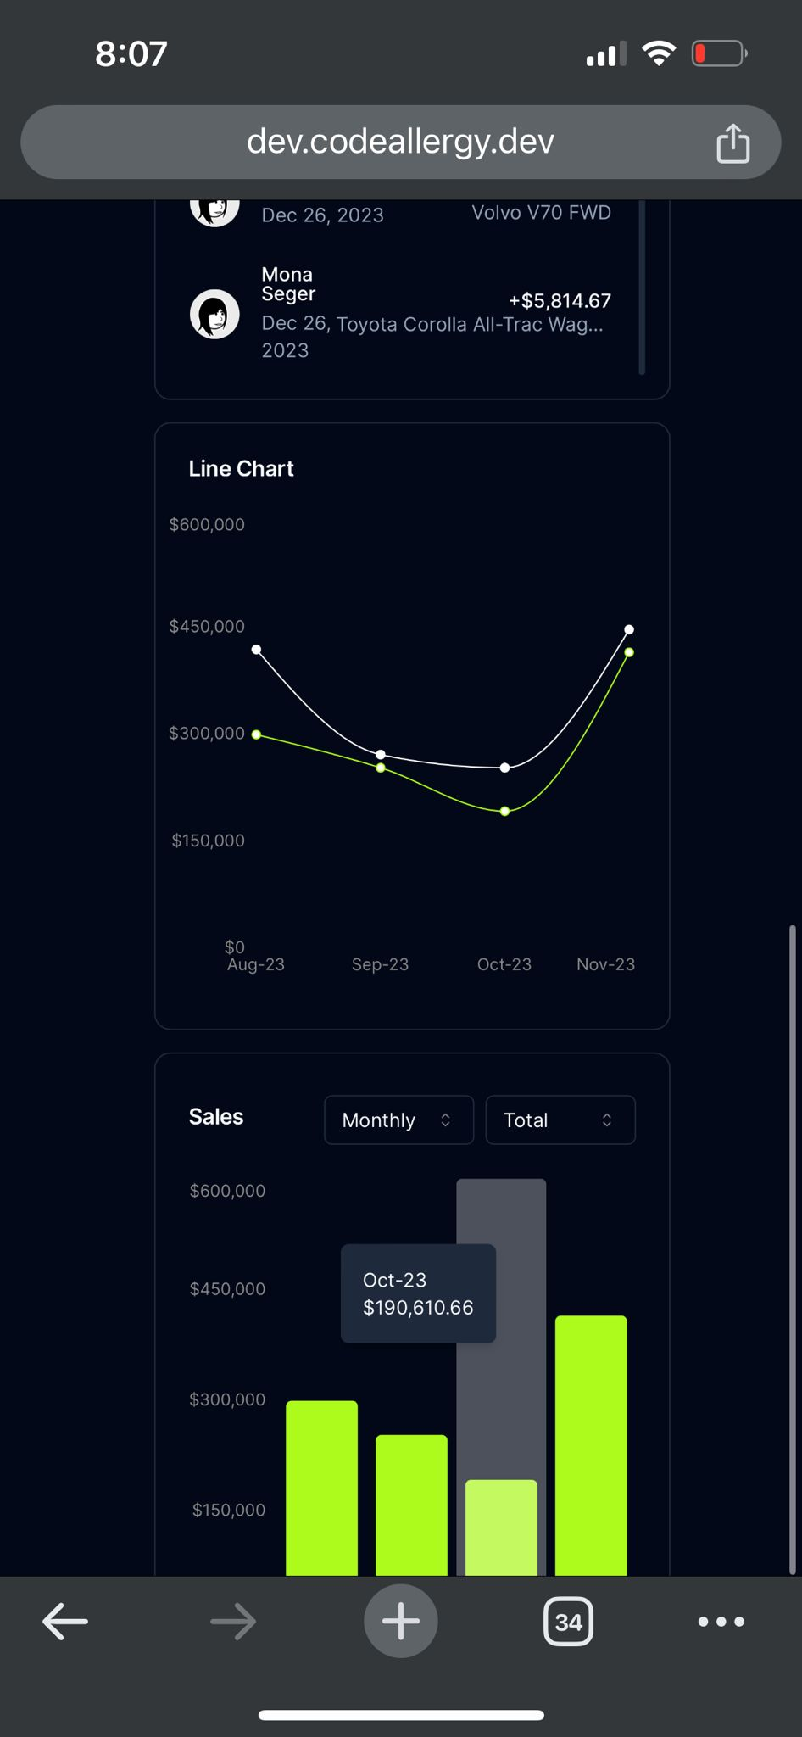
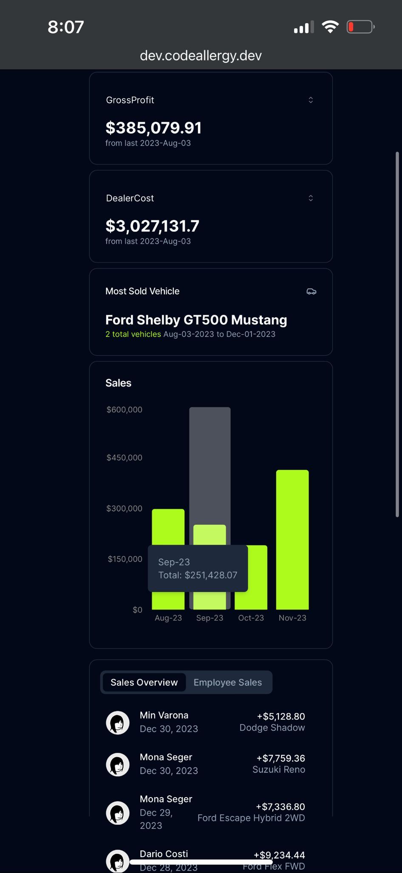
Mobile Version
Different layout to adjust to mobile screen

Slide 33
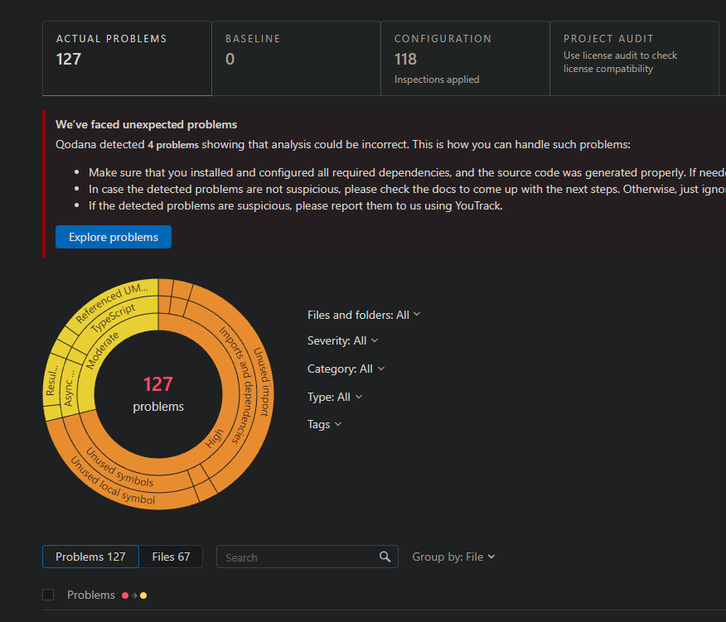
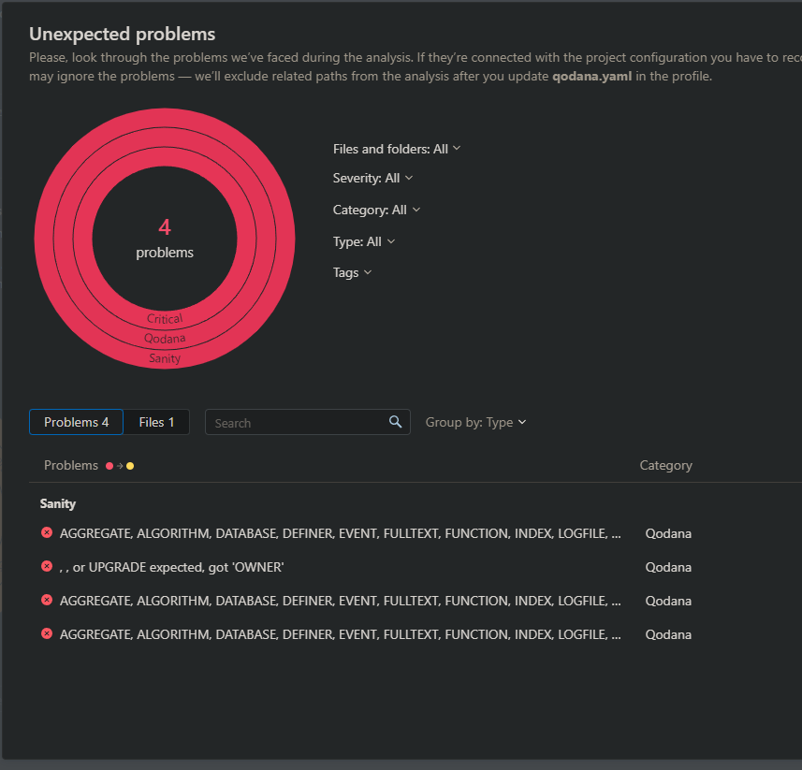
Quality of Assurance
Pipeline with Gitlab / Vercel
Qodana
Jest
Builds
Code reviews
Manual Testing

Slide 34
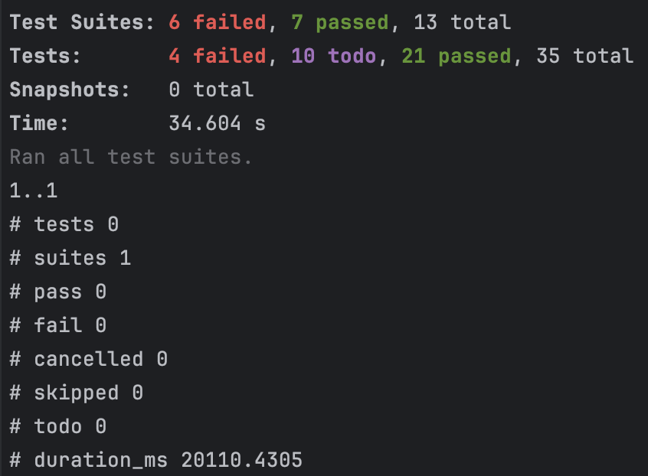
Automated Testing
Automated a few tests using jest
…And manually tested the whole website to ensure everything is working as expected

Slide 35
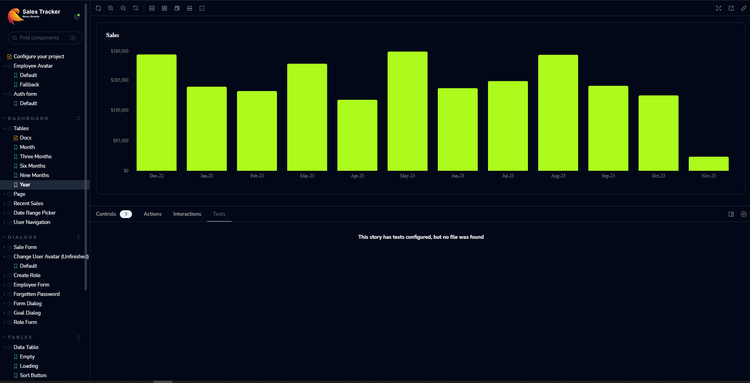
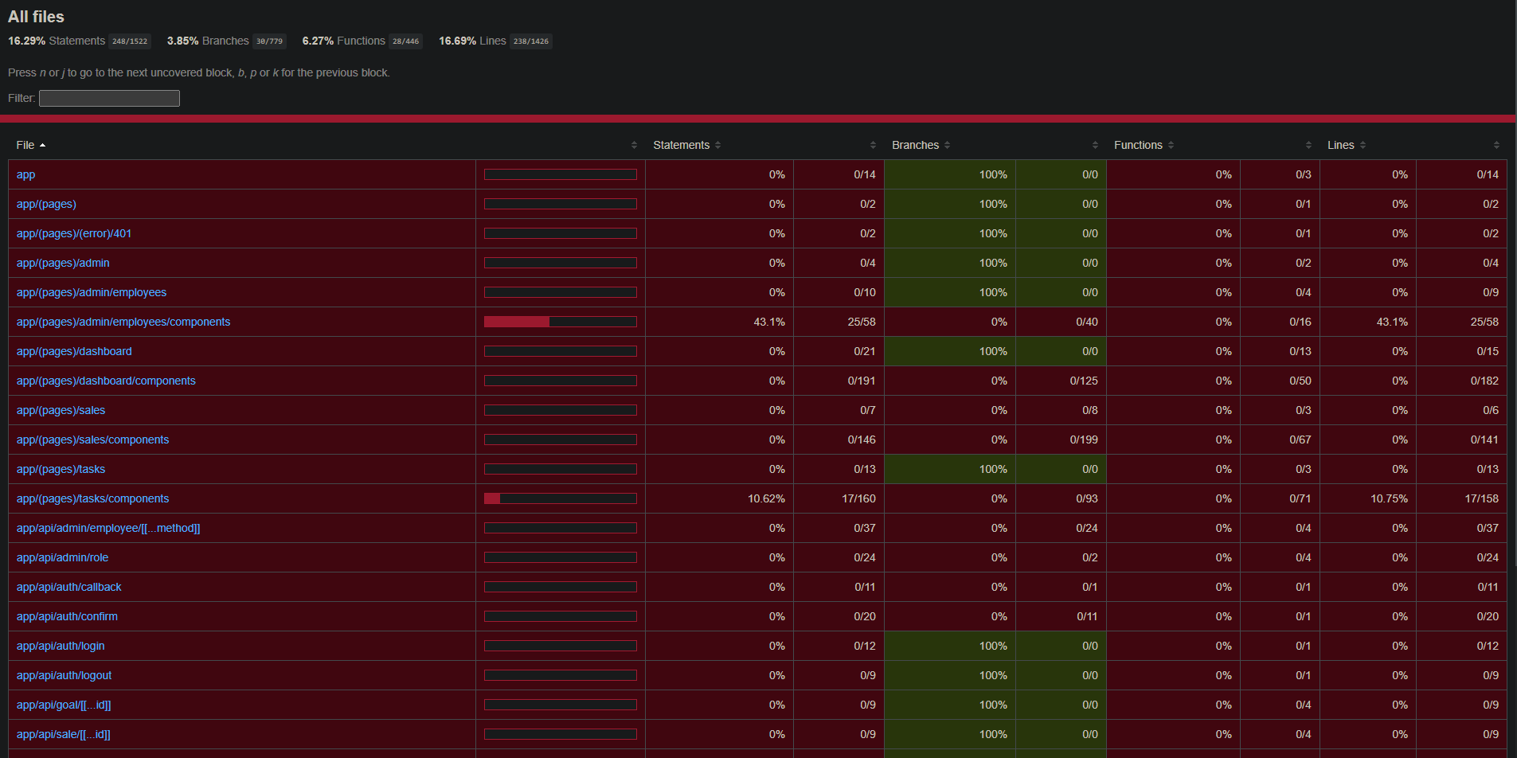
Stories / Coverage

Slide 36
NEXT STEP
https://youtu.be/WngUsIu1LJQ - Promo
https://www.youtube.com/watch?v=oY6Ra2OdxHQ - Demo
Code Style and Standards.
Use state management like Zustand

